Slide 1
Machine Learning of Handwritten Digits

Slide 2
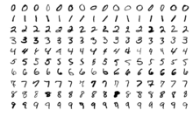
The Problem
Accurate identification of handwritten digits by classification models
K-Nearest Neighbors Classifier
Extra Trees Classifier

Slide 3
The Data
70,000 “images” of handwritten digits divided in two datasets
42,000 Training
28,000 Test
Each “image” consists of 784 pixels
Each pixel has one value (0-255) corresponding with gray scale color
Training dataset has extra column to include the label for each digit

Slide 4
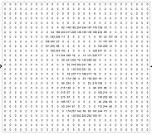
Image Example

Slide 5
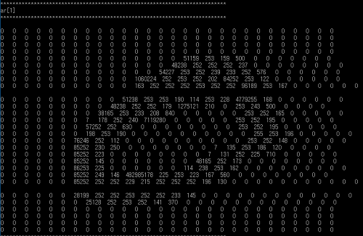
Image Example

Slide 6
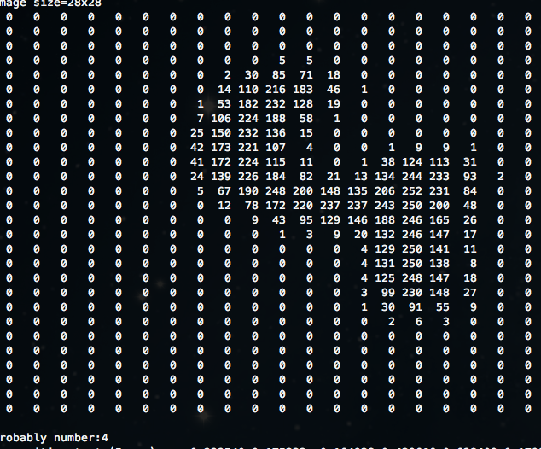
Image Example

Slide 7
Training Dataset Distribution

Slide 8
Digit Means

Slide 9
K-Nearest Neighbors
Classification by proximity
3
3
X
3
K=1
8
K=2
K=3
K=4

Slide 10
Which K To Use?

Slide 11
KNN Accuracy per Digit

Slide 12
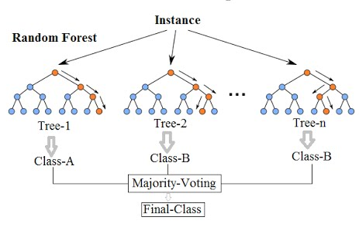
Extra Trees Classifier
Classification by numerous decision trees
Image

Slide 13
Extra Trees Accuracy per Digit

Slide 14
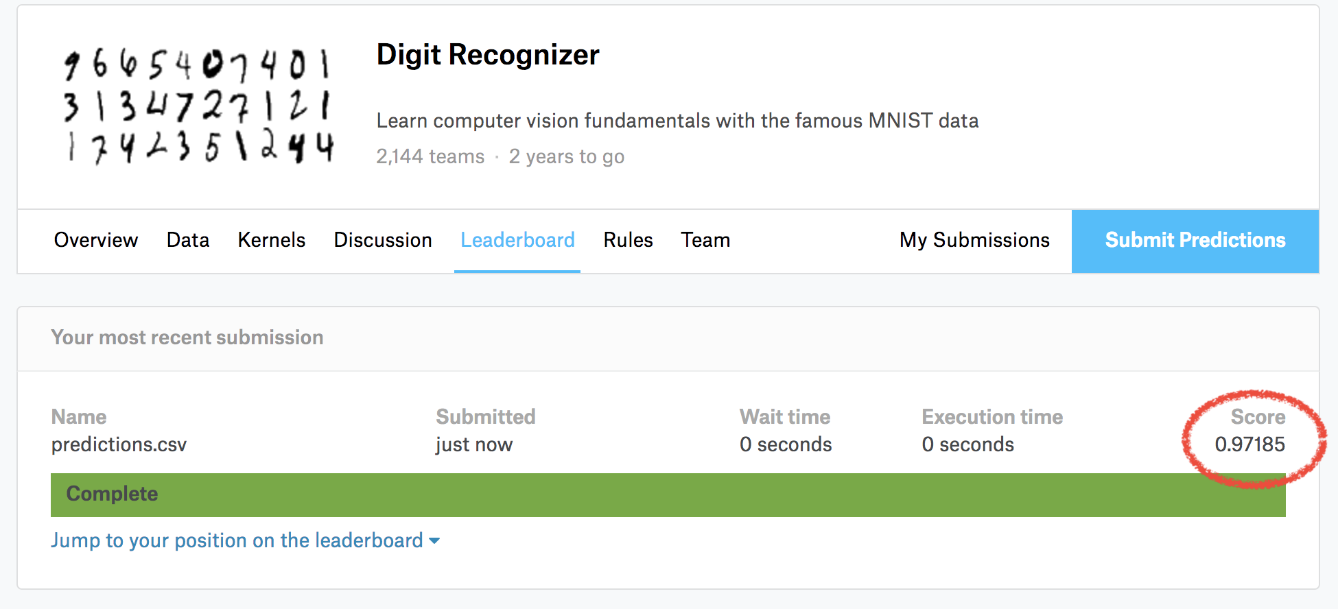
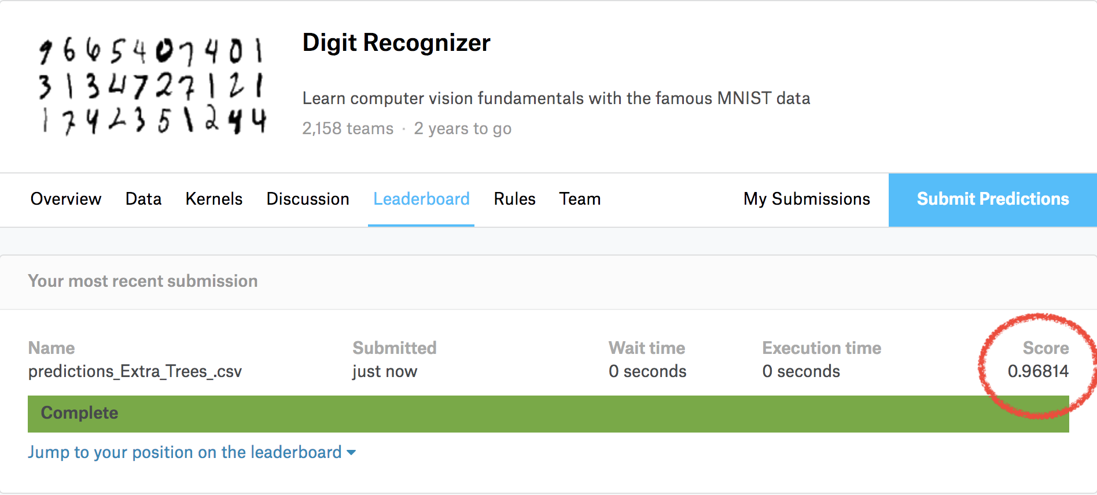
The Results
K-Nearest Neighbors
Extra Trees Classifier
Accuracy Score on Test Portion of Training Dataset: .972
Accuracy Score from Test Portion of Training Dataset: .970
Accuracy Score on Test Dataset: .97185
Accuracy Score on Test Dataset: .96814

